Slide 1
Use of visuals for presentation
The visuals generally used in oral presentations in conferences are,
1.Electronic presentation
2. Overhead transparencies
3.Slides for a Slide projector
4.Films and videos
5. Flip charts or writing board
However, electronic presentation by using software e,g. Power point is commonly used .
You have to make sure prior to your presentation that the equipment is compatible with your version of software and computer disks.
You must be capable of solving compatibility problems specially fine resolution

Slide 2
Benefits of Electronic presentation
Smooth transition from one display to another
Sequential build up of bullet points
Animation of tables, figures and other illustrations
You can present a line diagram or a flow chart sequentially
You can highlight a number in a table while discussing it in your talk
A message is better conveyed if a bullet point just appears on the screen, rather than coming “flying” or crawling.
Too many animations must be avoided in any display
It becomes difficult for the audience to grasp the meaning of the text,table or figure if it is changing all the time

Slide 3
Precautions to be taken
The room lights must be on to have eye contact with your audience therefore proper colors must be chosen for text and background (colors might look different on projection than how they looked on your computer.)
Keep back up transparencies in case things go wrong in electronic presentation. Bring an extra copy of presentation file on one or two external disks (floppy, USB,CD etc.)
Having a print out of your presentation is a wise step, specially if you are presenting in an international conference.
Certain problems occur due to non compatibilty between softwares or operating systems on computers used for preparing slides and for display.
The symbols or bullets may appear differently.
It is wise to use fonts which have been widely used for number of years, e.g. Times new Roman, Verdana, Ariel etc.

Slide 4
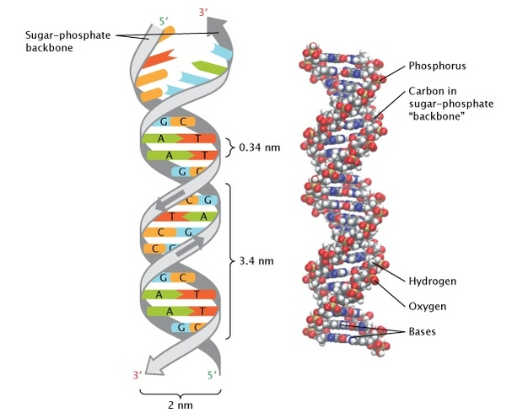
The double-helical structure of DNA. The 3-dimensional double helix structure of DNA, correctly elucidated by James Watson and Francis Crick. Complementary bases are held together as a pair by hydrogen bonds. © 2013 Nature Education All rights reserved.

Slide 6
Why produce GM Crops? (Benefits)
To strengthen the resistance against weeds and pests
To cope better with climatic changes i.e. drought,flood and frost (GM rice can be grown with much less water)
To improve the quality of products
To improve food production to feed the world
To minimize the cost of production
To minimize crop injury
To minimize loss during transport and storage

Slide 7
Controversies regarding GM foods
Will it affect our health?
Will it affect the eco-system?
Will it have harmful side-effects?
Will it reduce consumer choices?
Will we suffer from toxins produced?
Will we inherit the toxin-producing genes?
Will it cause allergic reactions?

Slide 8
Overhead Projector
It is supposed to be a reliable method of display.
Room lights can be fully on.
Screen has to be adjusted at correct angle
There should be space nearby to keep your transparencies
You can stand next to the projector and switch transparencies.(For this projector has to be kept at proper place)
You can reorganize, delete or add transparencies late or even during presentation.
You can even write on a blank transparency while displaying just like writing on board.
Keep your transparencies ready to use i.e. out of file and remove the in between papers.

Slide 9
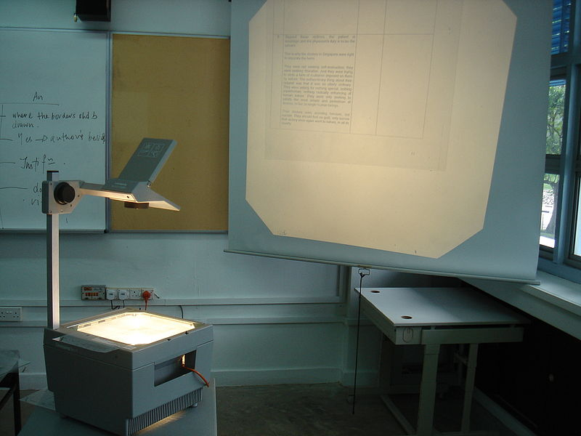
Overhead projector in operation

Slide 10
Slide projectors
Widely used in past
Now rarely used in some places where there is no facility for electronic display
Slides can be used to show text, tables, figures, photos & other illustrations
Room lights have to be dim
Sometimes disturbing noise is produced.
Difficult to go back to show some previous slide
Takes long time to prepare slides from computer displays
Standard of slide frames is different in different countries, in US (2mm) , in Europe (3mm), paper frames may also create trouble.

Slide 11
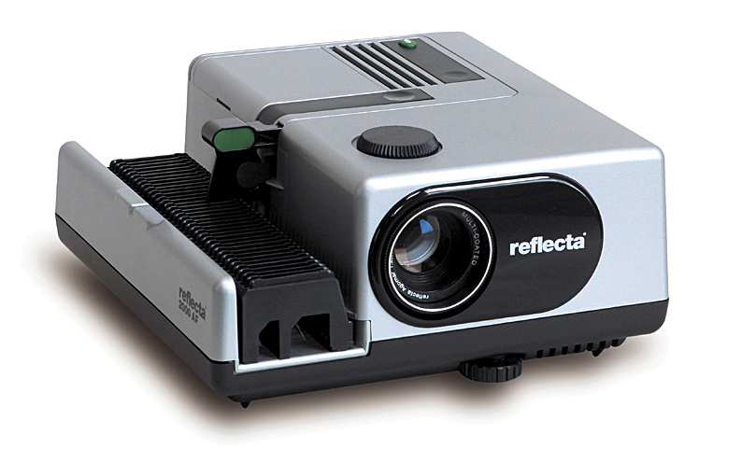
Slide projector

Slide 12
Flip Charts
A flip chart Consists of a pad of large paper sheets.
It is fixed to the upper edge of a white board,
typically supported on a tripod or four-legged
easel
Text is usually hand written with marker pens and may include figures or charts. A sheet can be flipped over by the presenter to continue to a new page.
Scientists have developed a digital self writing flip chart which writes word for word everything it is instructed to record.
The disability action group "Armless" has stated that this is a significant step forward for disabilities groups to have conferences like people without disabilities.
Also available are flipchart stands which are self heightening.

Slide 13
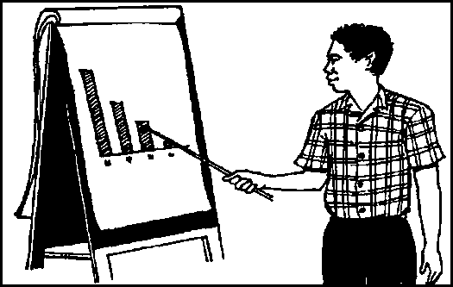
Flip Charts

Slide 14
Use of Flip Charts
Flip charts are used in many different settings such as:
in any type of presentation where the papers pads are pre-filled with information on a given topic
for capturing information in meetings and brainstorming sessions
in classrooms and teaching institutions of any kind
to record relevant information in manufacturing plants
a creative drawing board for Art students
a palette for artists in “life-drawing” classes
for strategy coaching for sports teams
for teaching

Slide 15
Creating visuals
Visual material supports the printed message.
The readers first scan graphics such as tables and figures to see if the paper is worth reading.
Graphics make paper writing easy by condensing content.
All types of presentation visuals i.e. electronic presentations, transparencies or slides can be created on computer.
Same display can be used for all three
Softwares are used for producing visuals, text processing, graphics, drawings.
Clip art or photos can be inserted using Photoshop.
Resolution is important
Copyright should not be infringed.

Slide 16
Most effective illustration for a given goal
Presenting exact values, raw data and such data which does not fit in any simple pattern ……………………………………………………………. Table/list
Interaction between variables,relate data to constants or emphasize an overall pattern rather than specific measurements…………………………Line graph
Draw comparison or dramatize differences…………………… Bar graph
To illustrate complex relationships, spatial configurations, pathways, processes or interactions …………………………………………………. ………………Diagram
To show sequential processes ………………………………………….Flow chart
To classify information………………………………… …..Table, list , pictograph
To describe parts or electric circuits……………………………….. Schematic
To describe process, organization or model………............................................Pictograph, Flowchart, block diagram
Compare/contrast………………………… Pictograph, Pie chart, bar graph
To show change of state………………………Line graph, Bar graph
To describe proportions………………………..Pie chart, bar graph
To describe relationships………………………Table, Line graph, block diagram
To describe entire object……………………..Schematic, drawing, photograph
To show vertical/horizontal hierarchy
within an object, idea or organization ……………….Flow chart, Drawing tree,
.. Block diagram

Slide 17
Tables
Table should be self contained to stand alone
It should not refer to text, equation,figure or another table
Title of the table should be descriptive enough to stand alone and also for reference in the text
Make body of the table concise ,avoid repetitive information ,avoid data that can be computed from available information.
Abbreviations can be used, but explain their meaning in foot note
Use logical format, arrange comparisons in columns(vertical) rather than rows(horizontal)
Organize the table to fit the page .
Orient table as “portrait” rather than “landscape”
Avoid vertical lines between columns
Use few horizontal lines
Use common units and double space every 5 lines for easy reading.
Avoid using zero or dash for absence of results, use ND (No data/not determined/Not detected) mention in foot note.
Tables are usually given at the end after references ,for typesetter to format tables separately according to layout of journal.
Mention at the location where you want that table in the published paper by writing “Table X near here” (It should always be near where you have mentioned it in the text)

Slide 18
Figures
Use only as many figures as necessary for explaining results
Figures are usually reduced in size for publication ,making it difficult to distinguish between lines
Use appropriate scale of lettering ,symbol size and boldness of line which should be consistent across figures
Figures should stand alone ,without reference to text, tables or other figures
Figures with multiple parts can be designated as 1a,1b,1c etc.
Appropriate caption/legends must be given
Pictographs, Bar charts, line graphs, pie charts , block diagrams , schematics are all examples of figures
Figures are given according to the style of the journal.These are inserted in the text near the comment that refers to it.
While submitting your manuscript read author’s instructions and place figures accordingly (usually after tables)
Avoid using colour in figures unless it is absolutely essential.

Slide 19
Pictograph
A pictorial symbol for a word or phrase. Pictographs were used as the earliest known form of writing, examples having been discovered in Egypt and Mesopotamia from before 3000 BC.
A pictorial representation of statistics on a chart, graph, or computer screen.
A pictogram, also called a pictogramme, pictograph, or simply picto and in computer usage an icon, is an ideogram that conveys its meaning through its pictorial resemblance to a physical object.
Pictographs are often used in writing and graphic systems in which the characters are to a considerable extent pictorial in appearance. A pictogram may also be used in subjects such as leisure, tourism and geography.

Slide 20
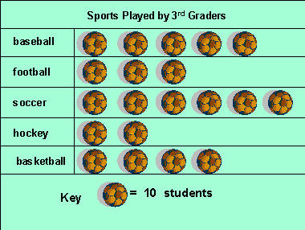
An example of pictograph

Slide 21
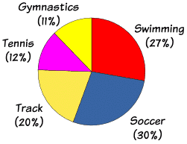
Pie chart
A pie chart (or a circle chart) is a circular statistical graphic, which is divided into slices to illustrate numerical proportion.
In a pie chart, the arc length of each slice (and consequently its central angle and area), is proportional to the quantity it represents.
Start at 12.00 with the largest and most important segment,go clockwise in logical order, keep no. of segments 5 or at the most 7,label segments outside the circle

Slide 22
Bar graph/chart/diagram
A bar chart or bar graph is a chart that presents grouped data with rectangular bars with lengths proportional to the values that they represent.
The bars can be plotted vertically or horizontally. A vertical bar chart is sometimes called a column bar chart.
A bar graph is a chart that use either horizontal or vertical bars to show comparisons among categories.
One axis of the chart shows the specific categories being compared, and the other axis represents a discrete value.
Some bar graphs present bars clustered in groups of more than one

Slide 23
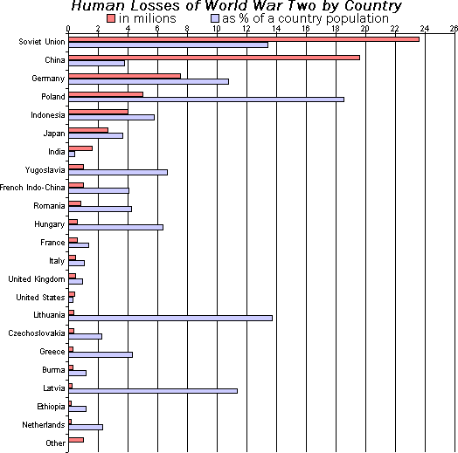
Example of Bar diagram

Slide 24
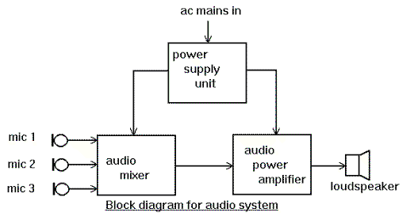
Block diagram
A diagram showing in schematic form the general arrangement of the parts or components of a complex system or process, such as an industrial apparatus or an electronic circuit.
A block diagram is a diagram of a system in which the principal parts or functions are represented by blocks connected by lines that show the relationships of the blocks. They are heavily used in engineering in hardware design, electronic design, software design, and process flow diagrams.

Slide 25
Schematic diagram
Schematic is showing the main parts of something usually in the form of a
simple drawing or diagram
A schematic, or schematic diagram, is a representation of the elements of a system using abstract, graphic symbols rather than realistic pictures.
A schematic usually omits all details that are not relevant to the information the schematic is intended to convey, and may add unrealistic elements that aid comprehension.
A schematic diagram, in particular of an electric or electronic circuit.
"only a few manufacturers provide schematics with their gear“
Schematics.com is a free online schematic editor that allows you to create and share circuit diagrams.

Slide 26
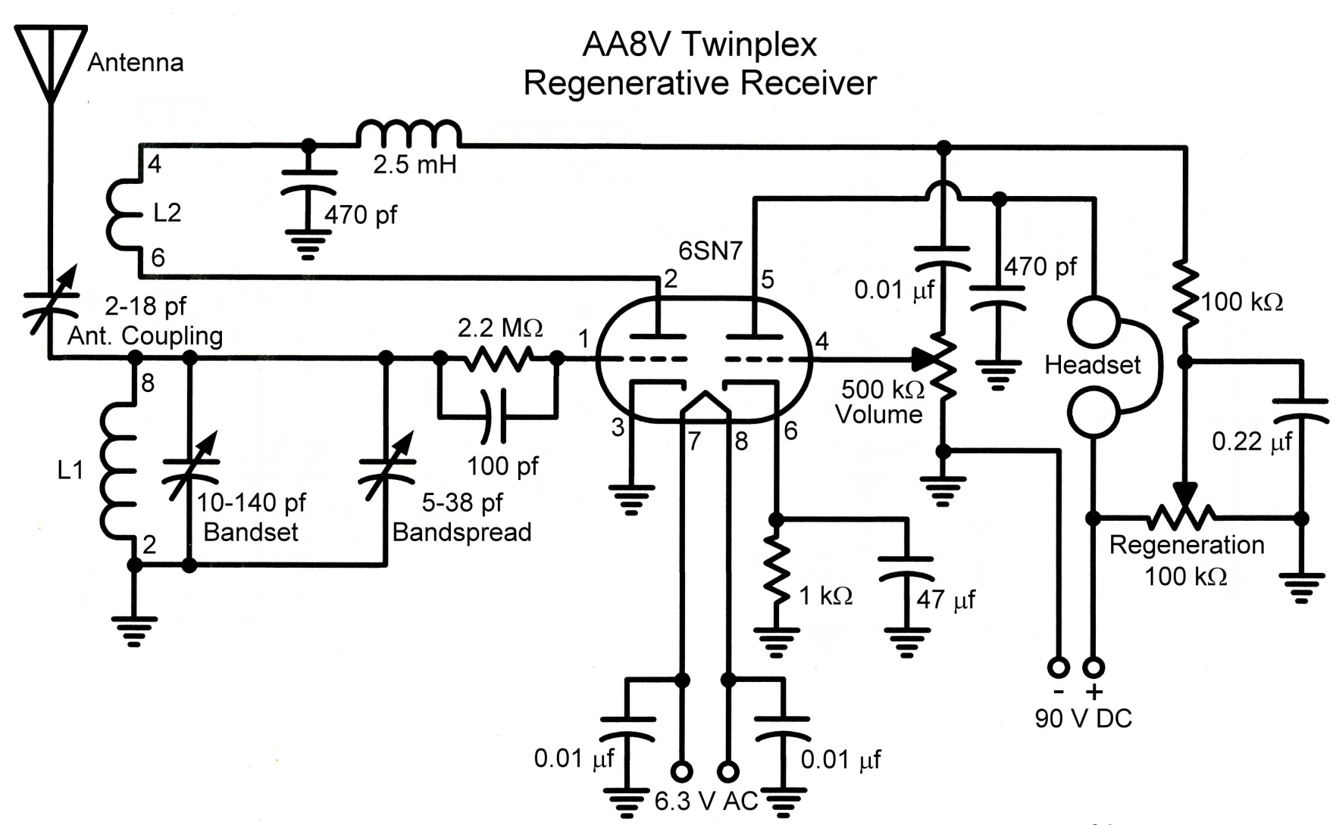
Schematic diagram

Slide 27
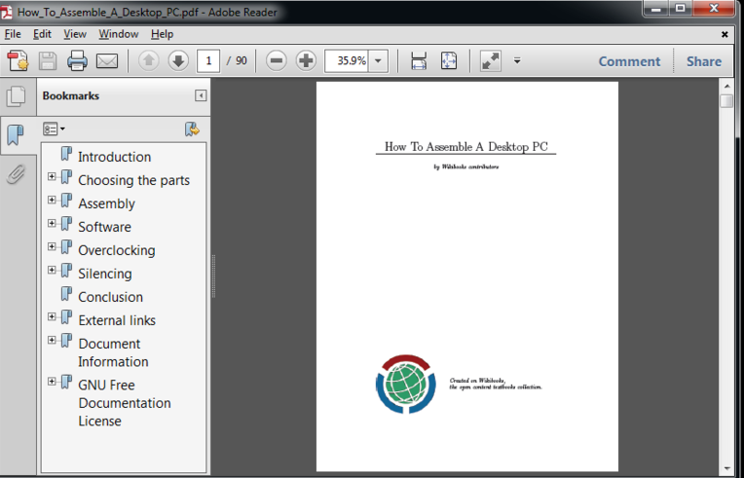
Adobe reader
Adobe Acrobat is a family of application software developed by Adobe Systems to view, create, manipulate, print and manage files in Portable Document Format (PDF).
It is available as freeware and can be downloaded from Adobe's web site.
Acrobat and Reader are widely used as a way to present information with a fixed layout similar to a paper publication.

Slide 28
Open source file format
IrfanView seeks to create unique, new and interesting features : It is free for non-commercial use, 32-Bit graphic viewer for Win 9x/ME/NT/2000/XP, with multiple (animated) GIF support and Multipage TIFF support.
Ghostscript: Ghostscript is a suite of software based on an interpreter for Adobe Systems' PostScript and Portable Document Format (PDF) page description languages.
MiKTeX project: MiKTeX is a typesetting system for the Windows operating system.

Slide 29
Other interesting text editors
LyX – An open source cross-platform word processor
Texmaker – An open source cross-platform editor and shell
TeXnicCenter – An open source Windows editor and shell
MeWa – An open source Windows editor based on TeXnicCenter
WinShell – A Windows freeware, closed-source multilingual integrated development environment (IDE)
#All of the above has been designed for LINUX platform

Slide 30
Search Engine at Glance
Scopus: The largest abstract and citation database of research literature and quality web sources covering nearly 18,000 titles from more than 5,000 publishers.
Scirus : most comprehensive scientific research tool on the web. With over 460 million scientific items indexed at last count, it allows researchers to search for not only journal content but also scientists' homepages, courseware, pre-print server material, patents and institutional repository and website information.

Slide 31
Cont..
Google Scholar: Provides a search of scholarly literature across many disciplines and sources, including theses, books, abstracts and articles.
h-INDEX: The h-index is an index that attempts to measure both the productivity and impact of the published work of a scientist or scholar. The index is based on the set of the scientist's most cited papers and the number of citations that they have received in other publications.

Slide 32
Digital Artwork
Artwork can take several forms: photographs, charts, graphs, diagrams, radiographs, etc. OR any scanned versions of these types of artwork.
To create artwork with a camera scanner or any piece of imaging software needed at the quality required for print.
To be of print-quality, artwork must be of high resolution, saved in the proper color mode and be of proper size.

Slide 33
Digital Art work
Before beginning to create new artwork or preparing existing artwork for print, determine which type of artwork you have
Image from a digital repository or other file archive
There is no way to increase the resolution of the file. Resolution is set when digital artwork is first created. If the quality is poor to begin with, there is no way to correct it. Inform the journal office if your artwork is an archive file in your cover letter or comments.
Photo or other scanned image.
Diagrams, drawings or graphs (line art) created with an art-based program
Use a non-Office suite program such as Photoshop or Adobe Illustrator. Creating art in Office suite programs like Corel DRAW, MS Word, etc. results in poor print quality and unusable JPG and GIF files
Images downloaded from the Internet.
These images are generally not acceptable for print due to universally low resolutions

Slide 34
Imaging Program
If the program will not allow you to alter the resolution of an image, it is probably not an imaging program.
Do not use Excel to create artwork.
GIF figures should never be submitted. Submit as JPEG or PNG figures.
If your diagrams, drawings or graphs (line art) are created in PowerPoint import the file into
Photoshop and save it as a TIFF or EPS file there. Be sure the resolution is set to 1200 dpi
If you do not have access to Photoshop, contact the editorial office for an alternate solution.
This may include the printing and mailing of the line art.

Slide 35
MS Paint
It is a simple graphics painting program that has been included with all versions of Microsoft Windows.
This tool is very useful for formating conversion resolution enhancement of figures used for publishing papers.
The program opens and saves files as Windows bitmap [24-bit, 256 color, 16 color, and monochrome, all with the .bmp{Best guess for Windows bitmap }]
extension), JPEG [jay – peg; Joint photographers expert group], GIF [Graphics Interchange Format] PNG [Portable network graphics] [without and with TIFF (Tagged image file format)] .
This tool offers versatile image creation and modification capability ,the extent of which depends on the user’s capabilities.

Slide 36
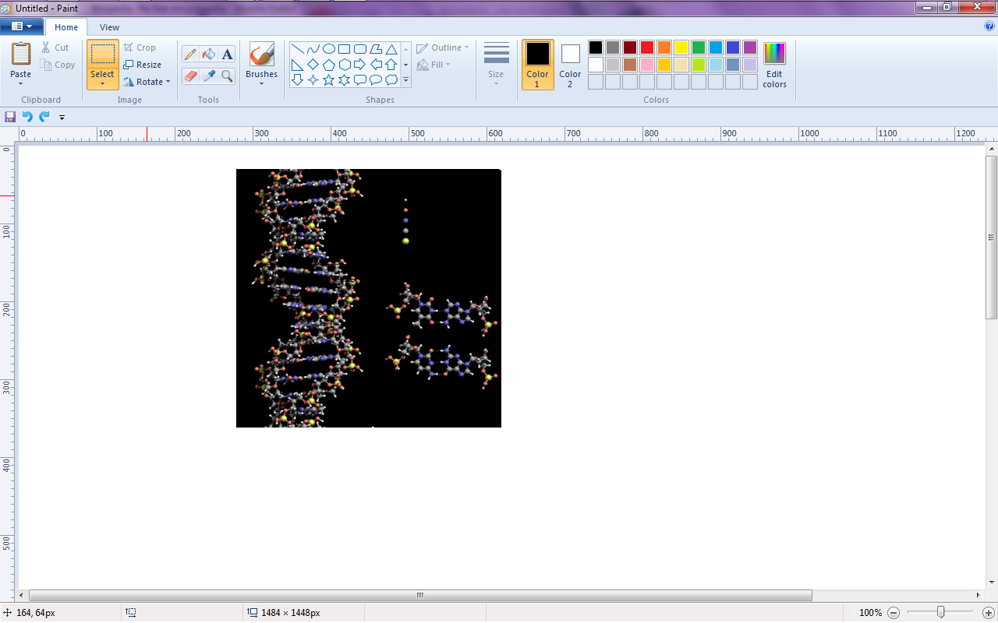
Tool Box
The program comes with the following options in its Tool Box (from left to right in image):
Free-Form Select
Select
Eraser/Color Eraser
Fill With Color
Pick Color
Magnifier
Pencil
Brush
Airbrush
Text
Line
Curve
Rectangle
Polygon
Ellipse
Rounded Rectangle

Slide 37
Step -1
Creating Digital Artwork by Scanner select Color Choice Before Scanning and Saving
COLOR vs. BLACK AND WHITE always choose B& W until unless colour is necessary
Some journals charge authors for the cost of printing color images – check with each journal first.
The graphic should be scanned as a grayscale image. (Also, files prepared in grayscale require much less computer space than files prepared in color)
For black & white :
Scan/photograph images and save in grayscale format.
For color
Scan/photograph images and save in CMYK mode (Cyan-Magenta-Yellow-blacK) Do not use RGB mode (red, green, and blue.)

Slide 38
Step 2.
Set Resolution Before Scanning and Saving
The resolution is often referred to as dpi (dots per inch). This will determine the ultimate clarity of your file.
The higher the resolution, the better the print quality
Once scanned/photographed and saved, the resolution of a file can never be increased again without distorting the proper print size of the image
For diagrams, drawings and graphs (purely black and white figures with no shades of gray):
Use a resolution of at least 1200 dpi (dots per inch) when scanning. Print out on a photo-quality printer and set your resolution to a minimum of 1200 at 100% final size.
For photographs, radiographs and scanned images:
Set the resolution to at least 300 dpi.

Slide 39
Step 3.
Set Target Size and Font Before Scanning, Photographing or Saving
SIZE & FONT
1 inch = 6 picas. 20 picas = 8.4 cm
Figures or images should be sized to fit the width of 1, 1.5, or 2 columns with no extra white or black space surrounding them (they should be scanned at around the same size you would like them to be published).
Column widths vary by publication. Measure the width of the columns in the journal to which you wish to submit.
Crop out or black out any patient identifiers.
If the figure or image contains text, make sure it’s embedded in the file, and use the Helvetica font
(between 8-12pt.).

Slide 40
Step 4. Name Your Files
SAVING & NAMING FILES
Save each piece of artwork separately in TIFF or EPS format.
PowerPoint is also acceptable.
Name figure files using this format: Last Name_Figure1.tif and Last Name Figure2.eps, etc.
“Last Name” is the corresponding author’s last name and the order indicates their order in the manuscript
(and ultimately the figure legend).

Slide 41
Step-5 Submit artwork
Submit figures to the journal according to their preferred method of delivery: online submission, e-mail, disk,
etc. as listed in their Instructions for Authors/Author Guidelines.
Compressing figures into one ZIP file speeds submission uploading process.
All electronic art that cannot be successfully uploaded must be submitted on a CD-ROM or an Iomega Zip disk, accompanied by high-resolution laser prints of each image (if available).
Extremely large files may “time out” as you try to upload them to an online manuscript submission tracking system.

Slide 42
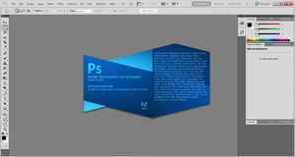
Adobe Photoshop
It is a graphics editing commercially available program developed and published by Adobe Systems Incorporated .
It is very standard tool for graphic design for web use, print layout etc. and has been recognized world-wide as the industry-standard.
Photoshop offers one of the most robust graphics editing experiences available .
Photoshop has the ability to read and write faster and vector image formats such as .EPS, .PNG, .GIF, and .JPEG.
In paper writing it ic commonly used for enhancing the dpi(dot per inches) setting for enhancing image qualities and image format conversion.

Slide 43
Photoshop enables the creation, incorporation, and manipulation of vector graphics through its Paths, Pen tools, Shape tools, Shape Layers, Type tools, Import command, and Smart object functions.
Utilization of these tools and commands provides convenience when it is desirable to combine pixel-based and vector-based images in one Photoshop document because it can eliminate the necessity to visit more than one software program and transfer files between them.
Photoshop functionality can be extended by add-on programs called Photoshop plugins like: filter, export, import, selection, automation, etc.
These plugins can either modify the current image or create the all new content.
Examples of few popular plugins are:
Color correction plugins :Alien Skin Software, Nik Software, OnOne Software, Topaz Labs Software, The Plugin Site,etc.
Special effects plugins : Alien Skin Software, Auto FX Software, AV Bros., Flaming Pear Software, etc.
3D effects plugins :Andromeda Software, Strata.

Slide 44
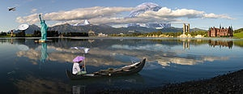
A landscape photo composed and manipulated in Photoshop

Slide 45
Software useful for writing Research paper
Win edt (www.winedt.com)
WinEdt is a powerful and versatile text editor for Windows with a strong predisposition towards the creation of LaTeX documents. It has been extensively tested under Windows XP, Vista, 7, and 8 (32-bit and 64-bit).
MiKTex (MiKTeX is open source)
MiKTeX (pronounced mick-tech) is an up-to-date implementation of TeX/LaTeX and related programs for Windows (all current variants).
TeX is a typesetting system written by Donald Ervin Knuth

Slide 46
Software useful for Typesetting Research paper
LyX (www.lyx.org )
LaTex (www.latex-project.org)
Aurora (http/.elevatorladay.ca )
Text studio (http://texstudio.sourceforge.net/)
Latexeditor (Led)(http://www.latexeditor.org/ )

Slide 47
What is LyX?
LyX is a document processor that encourages an approach to writing based on the structure of your documents and not simply their appearance .
LyX is an advanced open source document processor running on Linux/Unix, Windows, and Mac OS X.
It is called a "document processor", because unlike standard word processors, LyX encourages an approach to writing based on the structure of your documents, not their appearance.
LyX lets you concentrate on writing, leaving details of visual layout to the software.
LyX automates formatting according to predefined rule sets, yielding consistency throughout even the most complex documents.
LyX produces high quality, professional output – using LaTeX, an open source, industrial strength typesetting engine, in the background.

Slide 48
Why Aurora is good for you
No more mouse-hunting for symbols—enter great-looking math quickly and efficiently using the standard language of scientific typesetting.
Express any scientific concept from mathematics, computer science, chemistry, engineering, and many other areas.
Full integration with Microsoft® Word, PowerPoint®, Visio®, and Excel®.
Built-in LaTeX document converter.
Advanced support for equation numbering.
Works with any Windows application that has an “Insert Object...” function or lets you paste images.

Slide 49
Latex editor (LEd)
LaTeX Editor, called later LEd, is an environment for rapid TeX and LaTeX document development.
It is free to use.

Slide 50
Plagiarism finder softwares
Duplichecker
Viper
Plagscan
See Sources
Plagiarism detector
Plagium
Plagiarisma.net
Plag tracker

